Slide 1

ARTIFICIAL NEURAL NETWORKS

Slide 2






INSPIRATION FROM NATURE
Notes:
https://www.google.com/search?q=technology+that+was+inspired+from+nature&oq=&gs_lcrp=EgZjaHJvbWUqCQgAEEUYOxjCAzIJCAAQRRg7GMIDMgkIARBFGDsYwgMyCQgCEEUYOxjCAzIJCAMQRRg7GMIDMgkIBBBFGDsYwgMyCQgFEEUYOxjCAzIJCAYQRRg7GMIDMgkIBxBFGDsYwgPSAQk2MTEzajBqMTWoAgiwAgE&sourceid=chrome&ie=UTF-8

Slide 3
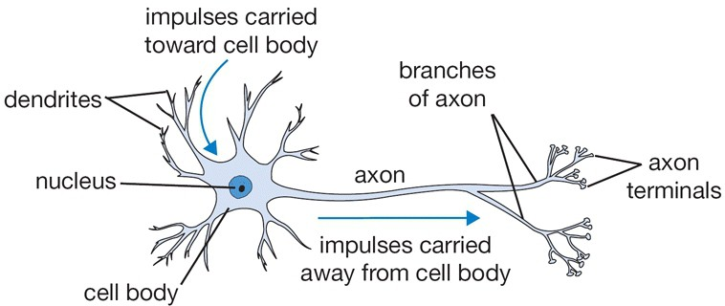
INSPIRATION: THE BRAIN
Many machine learning methods inspired by biology, e.g., the (human) brain
Our brain has ∼ 10¹¹ neurons, each of which communicates (is connected) to ∼ 10⁴ other neurons
Figure : The basic computational unit of the brain: Neuron
[Pic credit: http://cs231n.github.io/neural-networks-1/]

Slide 4
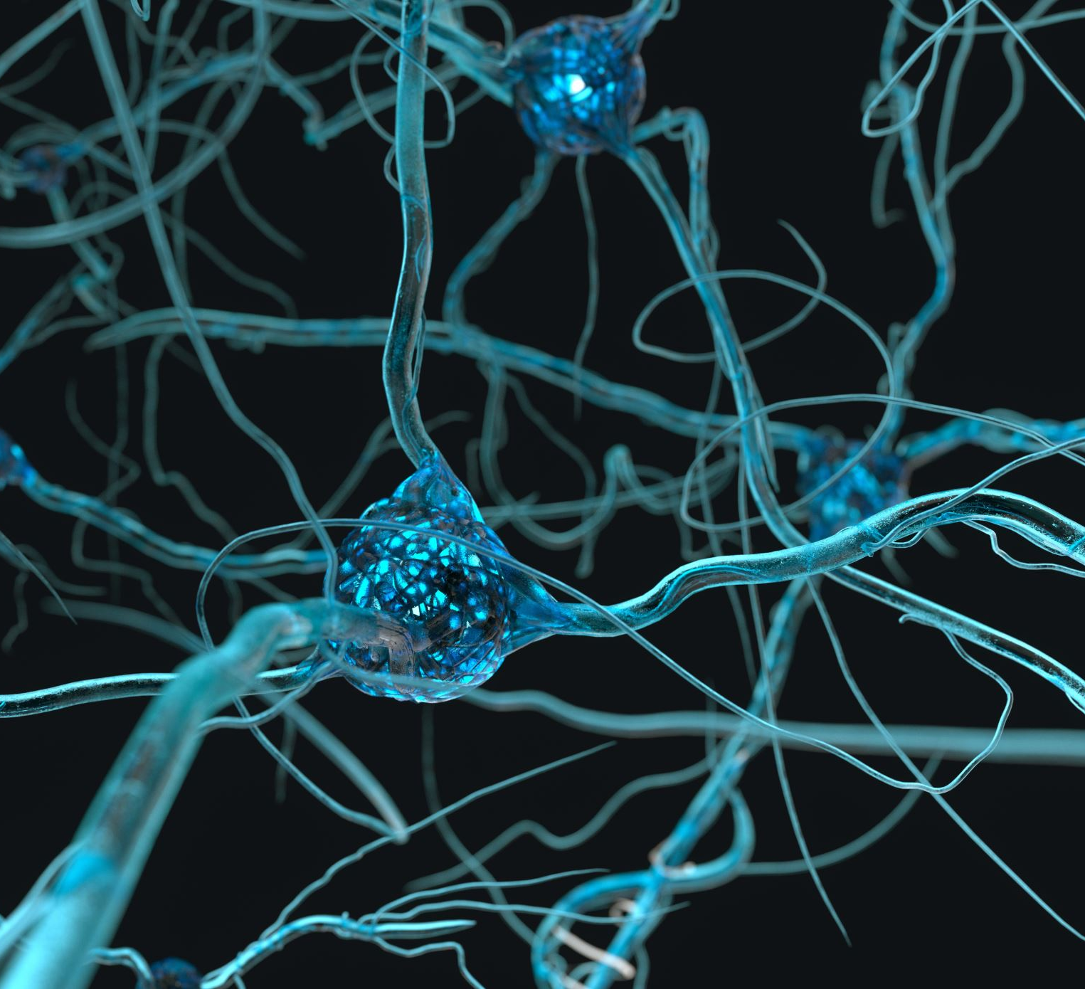
ARTIFICIAL NEURAL NETWORKS
Artificial Neural Networks (ANNs) are computational models inspired by biological neural networks.
Widely used in machine learning for classification, regression, clustering, and generative modeling.
The earliest models used simple linear functions.

Slide 5
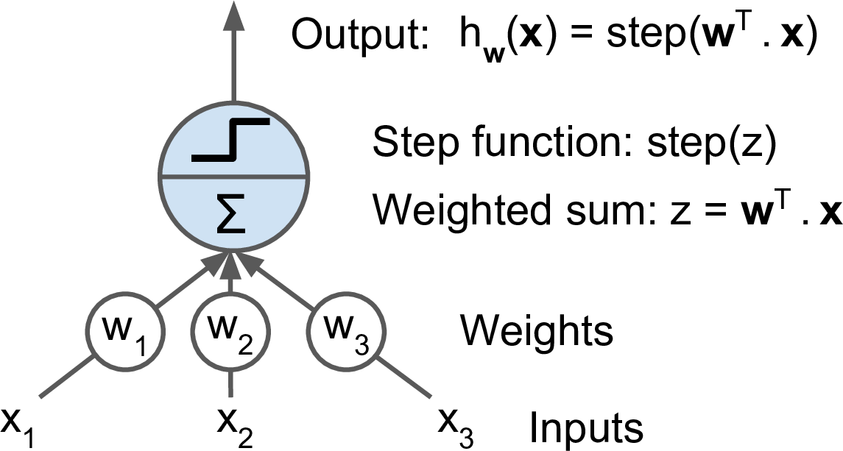
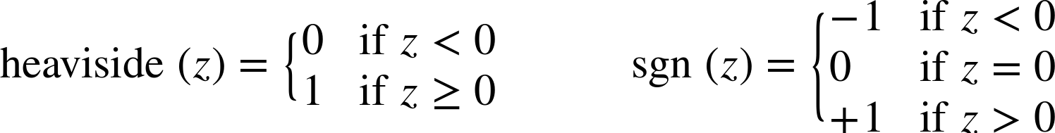
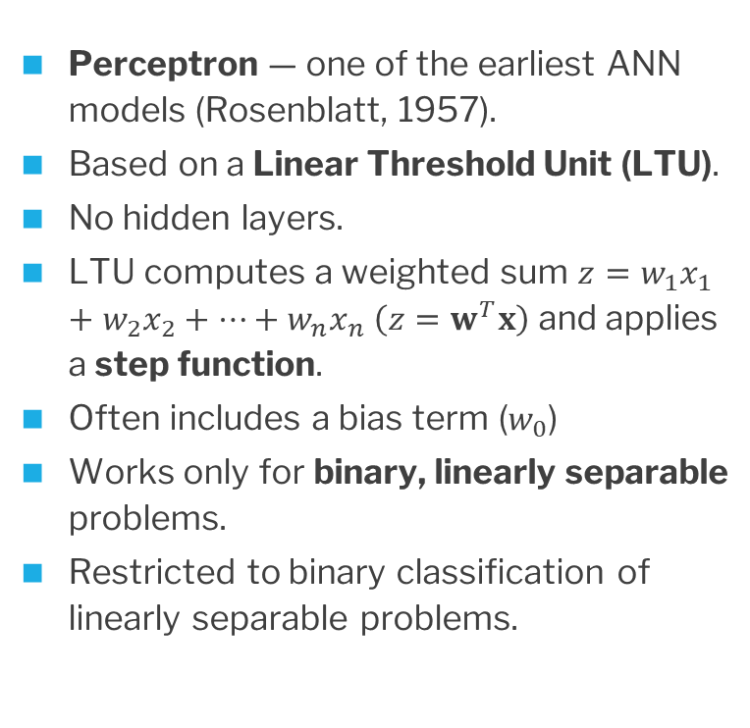
PERCEPTRONS
Perceptron — one of the earliest ANN models (Rosenblatt, 1957).
Based on a Linear Threshold Unit (LTU).
No hidden layers.
LTU computes a weighted sum $z=w_{1​}x_{1​}+w_{2​}x_{2​}+⋯+w_{n}​x_{n} \left(z=w^{T}x\right)$ and applies a step function.
Often includes a bias term ($w_{0}$)
Works only for binary, linearly separable problems.
Restricted to binary classification of linearly separable problems.

Slide 6

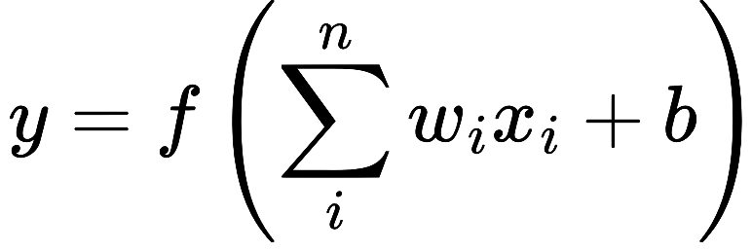
ARTIFICIAL NEURON STRUCTURE
Inputs: The features or data fed into the neuron.
Weights: Indicate the importance of each input.
Bias: Shifts the weighted sum for flexibility.
Activation Function: Computes output from weighted sum.
Output: The result of applying the activation.
The formula for the output is:
Notes:
Similar to perceptron but with non-linear activation function and hidden layers.

Slide 7
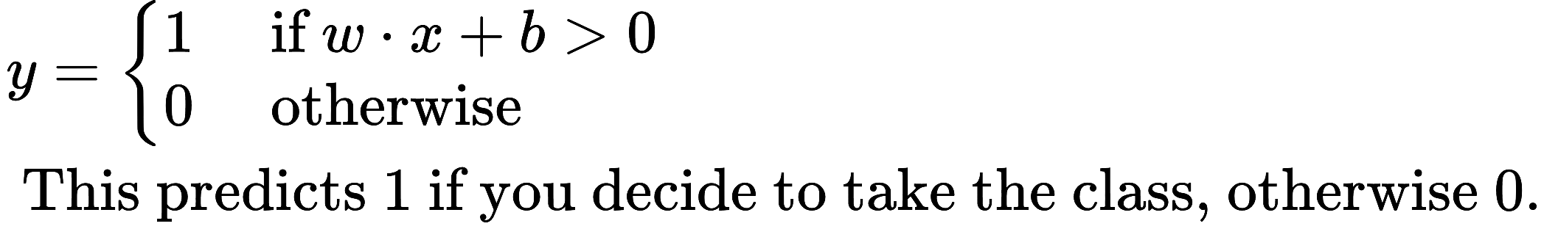
Example: Making a Class Decision with a Perceptron
You’re trying to decide whether to take a class based on the following features:
Is the class required? (1 = yes, 0 = no)
Is it offered before 9:00 a.m.? (1 = yes, 0 = no)
Is my significant other taking the class? (1 = yes, 0 = no)
Perceptron Model:
x = input vector = [x1​, x2​, x3​]
w = weights = [w1​, w2​, w3​]
b = bias

Slide 8
Decision Rule
Is the class required? (1 = yes, 0 = no)
Is it offered before 9:00 a.m.? (1 = yes, 0 = no)
Is my significant other taking the class? (1 = yes, 0 = no)
If true, take the class
Else: don’t take the class

Slide 9
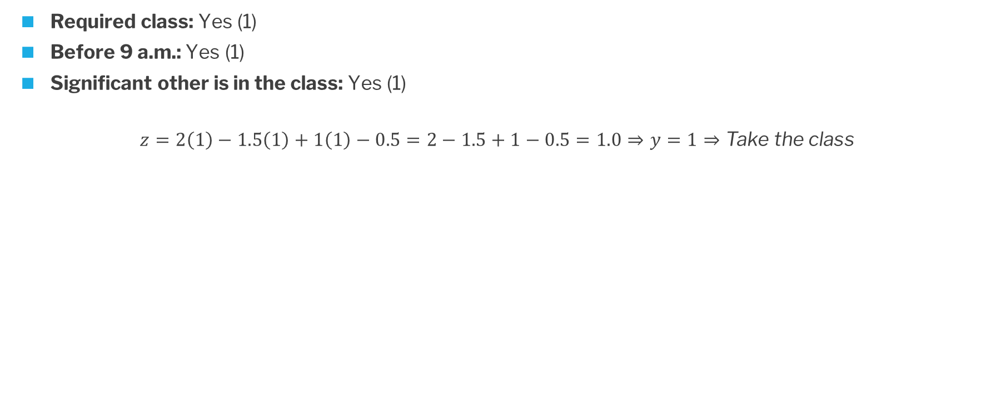
Example: Making a Class Decision with a Perceptron (Case 1)
Required class: Yes (1)
Before 9 a.m.: Yes (1)
Significant other is in the class: Yes (1)
$$z=2\left(1\right)−1.5\left(1\right)+1\left(1\right)−0.5=2−1.5+1−0.5=1.0⇒y=1⇒\text{Take} \text{the} \text{class}$$

Slide 10
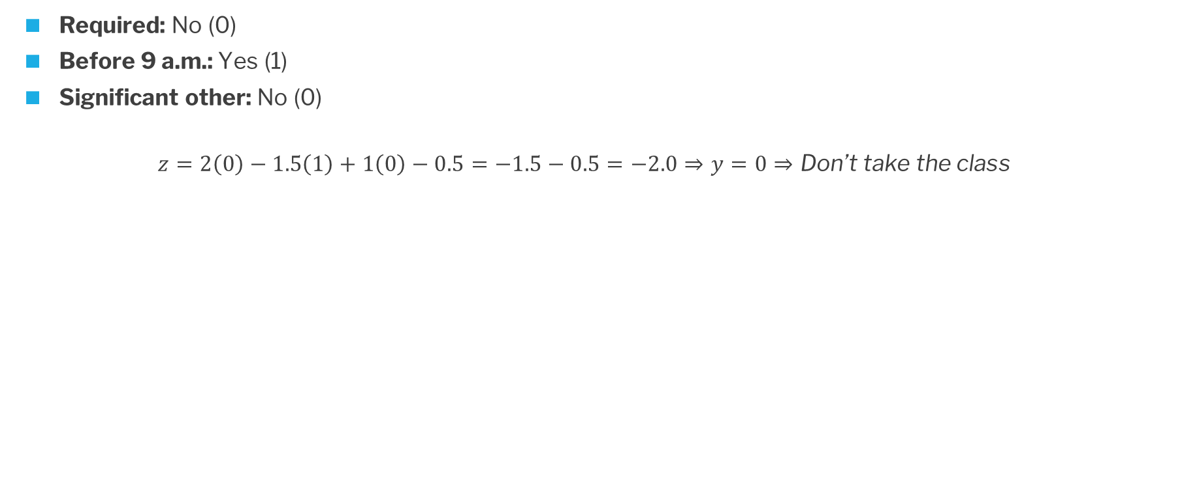
Example: Making a Class Decision with a Perceptron (Case 2)
Required: No (0)
Before 9 a.m.: Yes (1)
Significant other: No (0)
$$z=2\left(0\right)−1.5\left(1\right)+1\left(0\right)−0.5=−1.5−0.5=−2.0⇒y=0⇒\text{Don}\text{’}\text{t} \text{take} \text{the} \text{class}$$

Slide 11
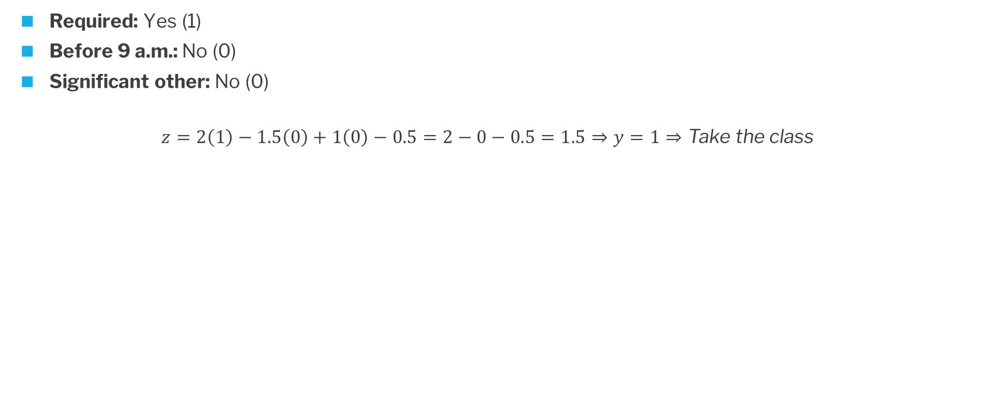
Example: Making a Class Decision with a Perceptron (Case 3)
Required: Yes (1)
Before 9 a.m.: No (0)
Significant other: No (0)
$$z=2\left(1\right)−1.5\left(0\right)+1\left(0\right)−0.5=2−0−0.5=1.5⇒y=1⇒\text{Take} \text{the} \text{class}$$

Slide 12
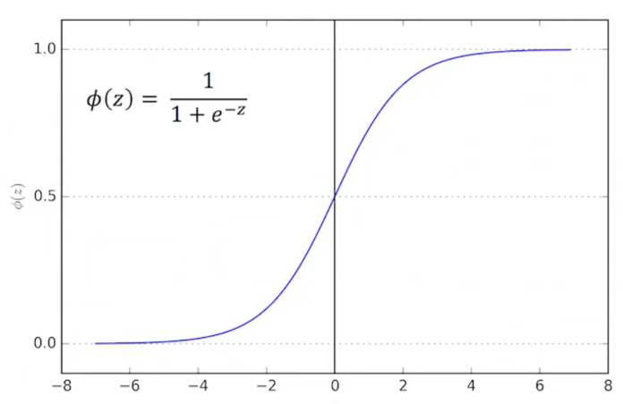
Logistic Regression and MLPs
Multilayer perceptron: add more layers to the perceptron with activations.
Logistic regression = no hidden layers, linear decision boundary with sigmoid (logistic) activation.
MLPs add hidden layers with nonlinear activations.
Same core idea: weighted inputs → activation → output.

Slide 13

NEURAL NETWORK ARCHITECTURE
ANNs are structured into layers:
Input Layer: Takes the features of the data.
Hidden Layers: Learn complex patterns.
Output Layer: Produces the final predictions.
The number of layers and neurons per layer influences the network’s capacity to learn.
Notes:
Include activation functions in discussion.

Slide 14
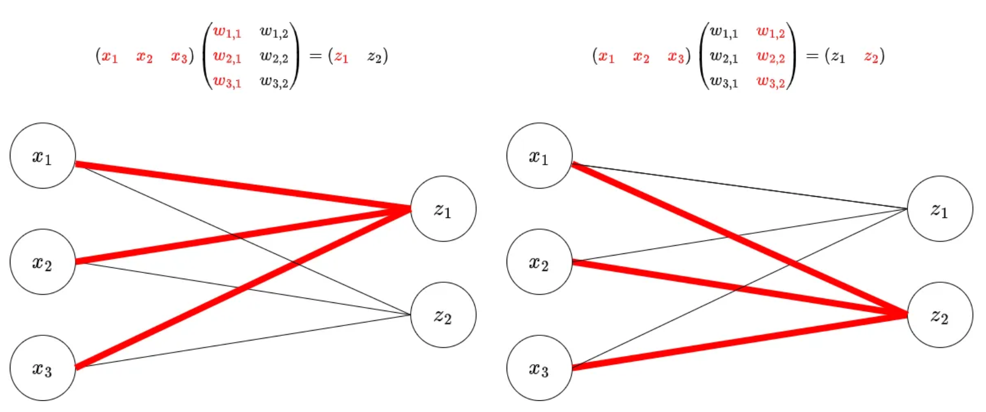
Weights Represented as Matrices
https://medium.com/@funcry/using-matrix-to-represent-fully-connected-layer-and-its-gradient-35604d99d138

Slide 15

ACTIVATION FUNCTIONS
Notes:
1. Sigmoid
Output: (0, 1)
Pros: Good for probabilities.
Cons: Vanishing gradients.
Use Case: Output layer for binary classification.
2. Tanh
Output: (-1, 1)
Pros: Zero-centered outputs.
Cons: Vanishing gradients.
Use Case: Situations requiring zero-centered activation.
3. ReLU (Rectified Linear Unit)
Output: [0, \infty)
Pros: Avoids vanishing gradients, efficient.
Cons: Dead neurons (outputs zero for negative inputs).
Use Case: Hidden layers in deep networks.
ReLU. The Rectified Linear Unit has become very popular in the last few years. It computes the function f(x)=max(0,x)f(x)=max(0,x). In other words, the activation is simply thresholded at zero (see image above on the left). There are several pros and cons to using the ReLUs:
(+) It was found to greatly accelerate (e.g. a factor of 6 in Krizhevsky et al.) the convergence of stochastic gradient descent compared to the sigmoid/tanh functions. It is argued that this is due to its linear, non-saturating form.
(+) Compared to tanh/sigmoid neurons that involve expensive operations (exponentials, etc.), the ReLU can be implemented by simply thresholding a matrix of activations at zero.
(-) Unfortunately, ReLU units can be fragile during training and can “die”. For example, a large gradient flowing through a ReLU neuron could cause the weights to update in such a way that the neuron will never activate on any datapoint again. If this happens, then the gradient flowing through the unit will forever be zero from that point on. That is, the ReLU units can irreversibly die during training since they can get knocked off the data manifold. For example, you may find that as much as 40% of your network can be “dead” (i.e. neurons that never activate across the entire training dataset) if the learning rate is set too high. With a proper setting of the learning rate this is less frequently an issue.

Slide 16
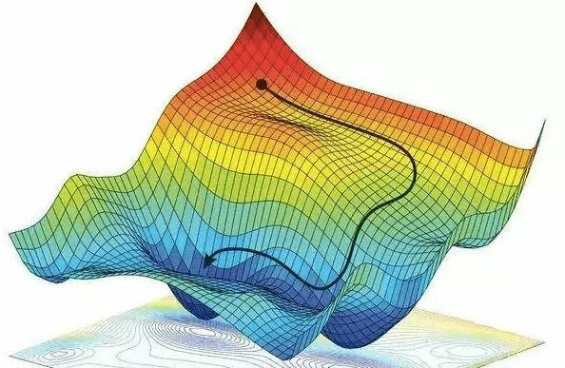
TRAINING PROCESS
1. Forward propagate the input.
2. Calculate the loss.
3. Backpropagate the error to update weights and biases.
4. Repeat for multiple epochs until loss below threshold.
Weights and biases are updated to minimize a cost function using an optimization process (e.g., gradient descent)
Gradient descent can be visualized as finding the most direct path to the bottom of a canyon (see figure)

Slide 17
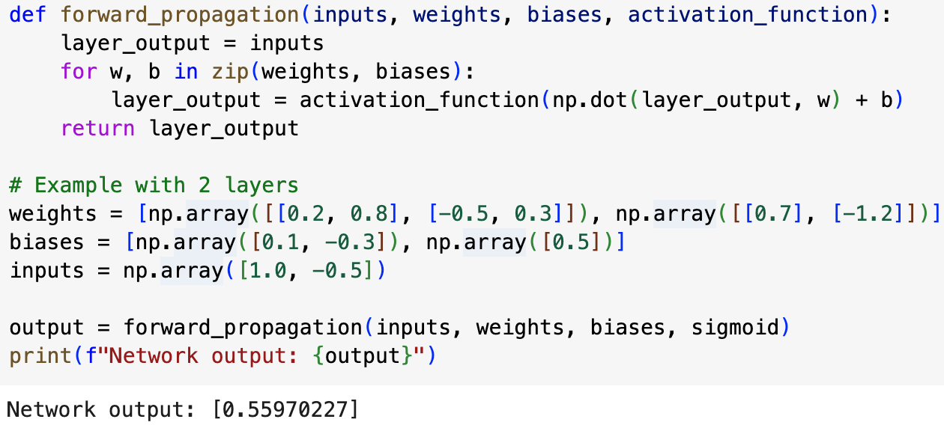
FORWARD PROPAGATION
The process of passing input data through the network to compute the output.
Steps:
1. Multiply inputs with weights and add biases.
2. Apply activation functions at each neuron.
3. Pass the outputs to the next layer.
Notes:
Imagine weights as [w1, w2] and biases as [b1, b2]. zip(weights, biases) would create pairs: [(w1, b1), (w2, b2)]. The loop then processes each layer using the corresponding weight and bias pair.

Slide 18
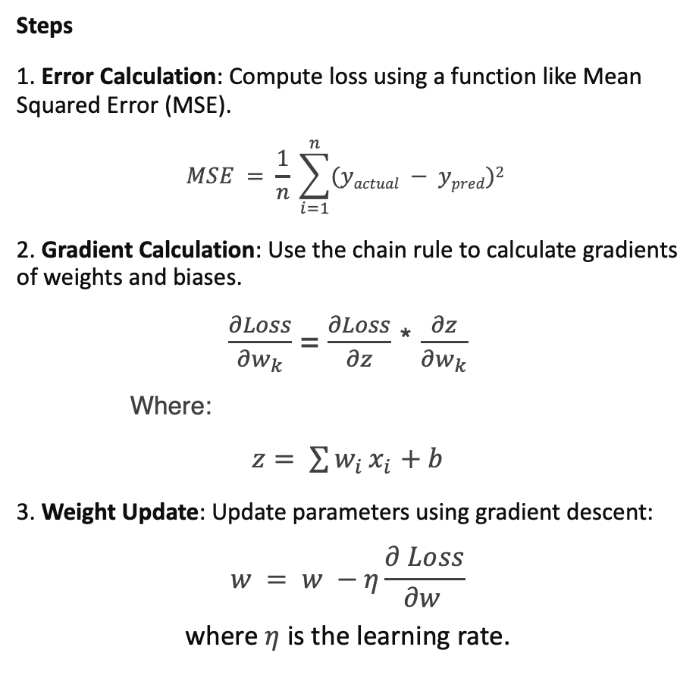
BACKPROPAGATION
Backpropagation trains neural networks by reducing the difference between predicted and actual outputs.
It works by calculating how much each weight and bias affects the error.
Errors are sent backward through the network to update weights and biases.
Uses the chain rule from calculus to compute gradients efficiently.
Notes:
Intuition
• Backpropagation ensures that each parameter in the network is adjusted based on how much it contributed to the overall error.
• It enables deep networks with many layers to learn complex mappings by efficiently distributing the error signal across layers.

Slide 19
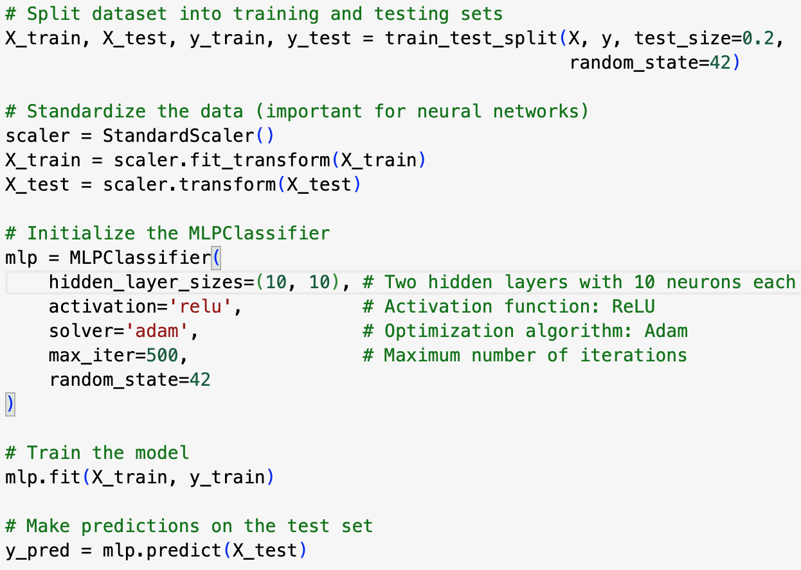
PYTHON EXAMPLE
Explanation of Key Parameters
hidden_layer_sizes: Tuple specifying the number of neurons in each hidden layer. In this case, two layers with 10 neurons each.
activation: Activation function for the neurons.
Options: 'identity', 'logistic', 'tanh', 'relu'.
solver: Optimization algorithm.
Options: 'lbfgs', 'sgd', 'adam'.
max_iter: Maximum number of iterations for training.
https://colab.research.google.com/drive/18zuW6teHF4of6dtXNiVG7eoshursaifN?usp=sharing

Slide 20
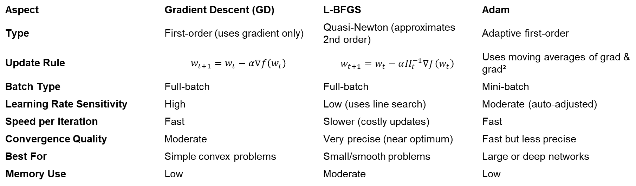
Scikit Learn Optimizers (MLP)
Aspect | Gradient Descent (GD) | L-BFGS | Adam
Type | First-order (uses gradient only) | Quasi-Newton (approximates 2nd order) | Adaptive first-order
Update Rule | $$w_{t+1}=w_{t}−α∇f\left(w_{t}\right)$$ | $$w_{t+1}=w_{t}−αH_{t}^{−1}∇f\left(w_{t}\right)$$ | Uses moving averages of grad & grad²
Batch Type | Full-batch | Full-batch | Mini-batch
Learning Rate Sensitivity | High | Low (uses line search) | Moderate (auto-adjusted)
Speed per Iteration | Fast | Slower (costly updates) | Fast
Convergence Quality | Moderate | Very precise (near optimum) | Fast but less precise
Best For | Simple convex problems | Small/smooth problems | Large or deep networks
Memory Use | Low | Moderate | Low

Slide 21
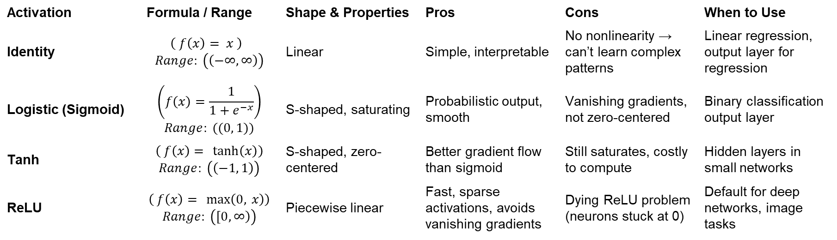
Activation Function Tables (Scikit Learn Options)
Activation | Formula / Range | Shape & Properties | Pros | Cons | When to Use
Identity | $$\left( f\left(x\right)= x \right)$$ $$Range: \left(\left(−∞, ∞\right)\right)$$ | Linear | Simple, interpretable | No nonlinearity → can’t learn complex patterns | Linear regression, output layer for regression
Logistic (Sigmoid) | $$\left(f\left(x\right)=\frac{1}{1+e^{−x}}\right)$$ $$Range: ((0, 1))$$ | S-shaped, saturating | Probabilistic output, smooth | Vanishing gradients, not zero-centered | Binary classification output layer
Tanh | $$\left( f\left(x\right)= \tanh\left(x\right)\right)$$ $$Range: \left(\left(−1, 1\right)\right)$$ | S-shaped, zero-centered | Better gradient flow than sigmoid | Still saturates, costly to compute | Hidden layers in small networks
ReLU | $$\left( f\left(x\right)= \max\left(0, x\right)\right)$$ $$Range: \left(\left[0, ∞\right)\right)$$ | Piecewise linear | Fast, sparse activations, avoids vanishing gradients | Dying ReLU problem (neurons stuck at 0) | Default for deep networks, image tasks

Slide 22
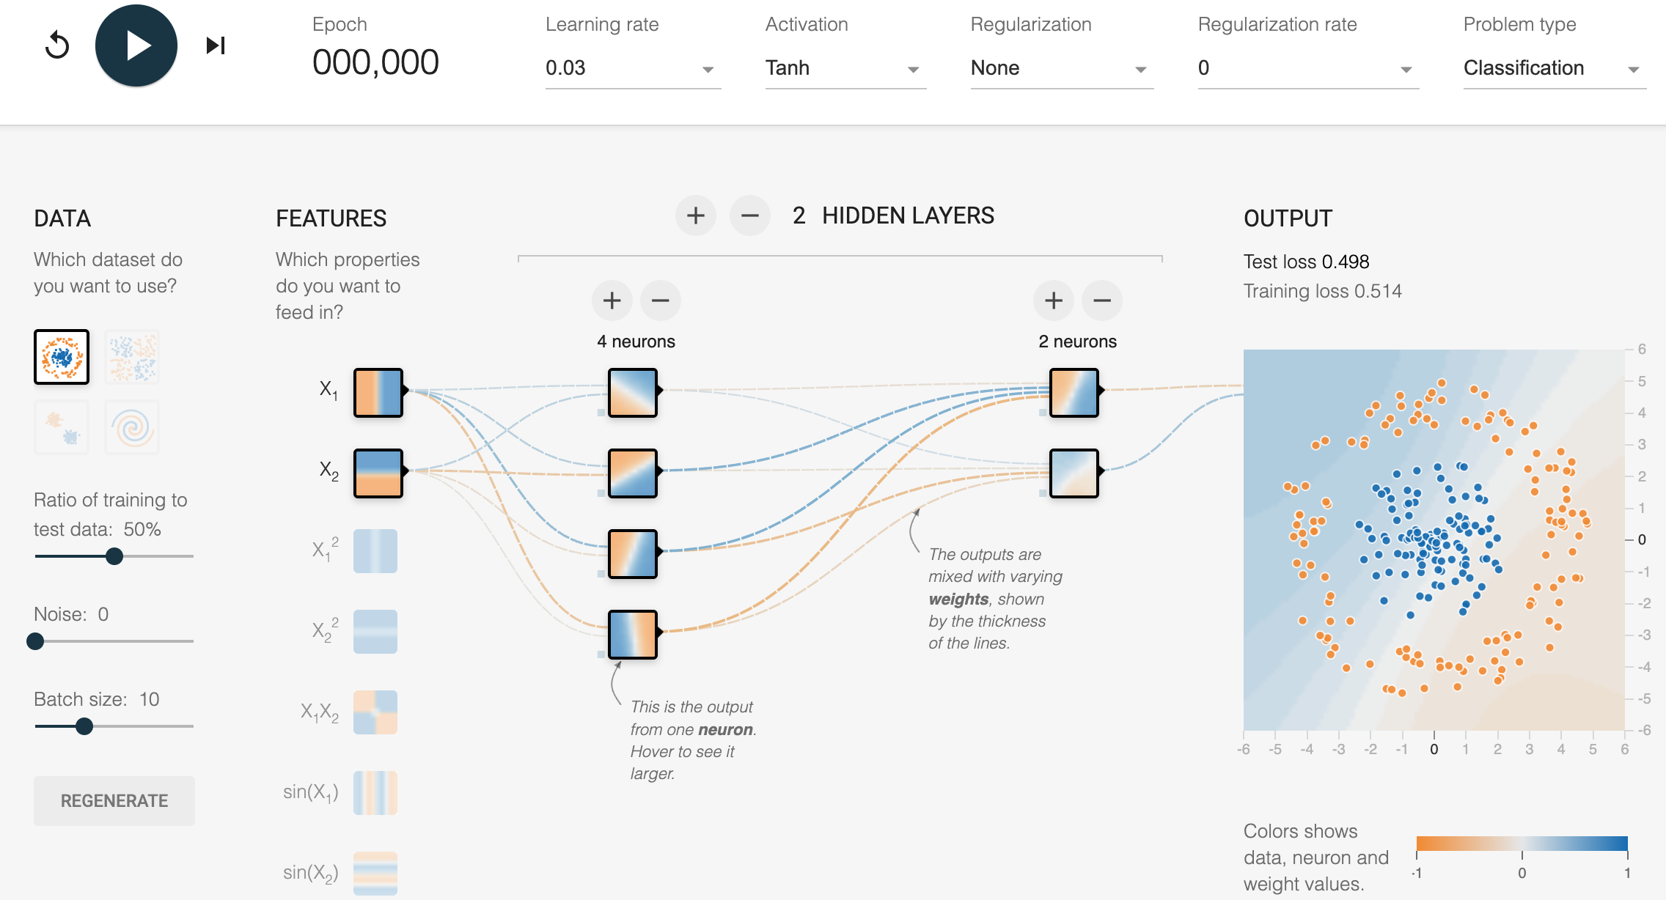
EXPERIMENT WITH NEURAL NETWORK PLAYGROUND
https://playground.tensorflow.org/

Slide 23
UNIVERSAL APPROXIMATION THEOREM
A neural network with one hidden layer and non-linear activations can approximate any continuous function.
Single Hidden Layer:
One hidden layer is enough for approximation.
May need many neurons → can be inefficient.
Practical Notes:
The theorem doesn’t say how many neurons are needed.
Deeper networks are often more efficient.
Doesn’t specify how to find the approximator.
Limitations:
Size: May need too many neurons → inefficient or overfit.
Training: Assumes perfect training, which is hard in practice.
Discontinuities: Only applies to continuous functions.
Notes:
Neural networks are universal function approximators because they can represent any continuous function with sufficient neurons and non-linear activation functions. This flexibility underpins their success in solving diverse problems across domains like computer vision, natural language processing, and time-series analysis.
DISCUSS WITH YOUR CLASSMATES!
Lets talk about that!
Why is that powerful?

Slide 24

REPRESENTATIONAL POWER
Neural network with at least one hidden layer is a universal approximator (can represent any function).
Proof in: Approximation by Superpositions of Sigmoidal Function, Cybenko, paper
The capacity of the network increases with more hidden units and more hidden layers
Why go deeper? Read e.g.,: Do Deep Nets Really Need to be Deep? Jimmy Ba, Rich Caruana, Paper: paper]
[http://cs231n.github.io/neural-networks-1/]
14 / 62

Slide 25
GLOSSARY
Activation Function: A mathematical function that introduces non-linearity into a neural network.
Backpropagation: The central algorithm for training artificial neural networks. It uses gradient descent to minimize the difference between the network's predictions and the actual target values.
Bias: A value added to the weighted sum of inputs for each neuron. Biases help shift the activation function, allowing for more flexibility in the network's learning.
Cost Function: Also known as the loss function, this function measures the difference between the network's predictions and the target values.
Gradient Descent: An optimization algorithm that iteratively adjusts the weights and biases of a neural network to minimize the cost function. It calculates the gradient of the cost function with respect to each parameter and updates the parameters in the direction of the negative gradient.
Hidden Layers: Layers in a neural network between the input and output layers.
Input Layer: The first layer in a neural network that receives the initial data.
Logistic Function/Curve: Also known as the Sigmoid function, this function squashes the output of a neuron to a value between 0 and 1. It's often used in the output layer for binary classification tasks.
Multi-layer Perceptron (MLP): A type of feedforward neural network with one or more hidden layers.
Neuron: The basic building block of a neural network. Each neuron receives input from other neurons, performs a weighted sum of its inputs, applies an activation function, and passes the output to other neurons.
Output Layer: The final layer in a neural network that produces the network's predictions or classifications.
ReLU (Rectified Linear Unit): An activation function that outputs 0 for negative inputs and the input value for positive inputs. It's a popular choice for its computational efficiency and effectiveness in many applications.
Softmax Function: An activation function that outputs a probability distribution over multiple classes. Typically used in the output layer for multi-class classification tasks.
Tanh (Hyperbolic Tangent): An activation function similar to the Sigmoid function but squashes the output to a value between -1 and 1.
Weights: Numerical values that determine the strength of connections between neurons. They are adjusted during the learning process to minimize the cost function.

Slide 26
REFERENCES
3blue1brown Overview of Neural Networks: https://www.3blue1brown.com/lessons/neural-networks
https://www.youtube.com/watch?v=aircAruvnKk&list=PLZHQObOWTQDNU6R1_67000Dx_ZCJB-3pi
Understanding Backpropagation: https://towardsdatascience.com/understanding-backpropagation-abcc509ca9d0
Backpropagation – A Visual Walkthrough: https://www.youtube.com/watch?v=9d2fwGjyb4M
Multilayer Perceptron Classifier (MLPClassier): https://michael-fuchs-python.netlify.app/2021/02/03/nn-multi-layer-perceptron-classifier-mlpclassifier/

